Slide 1
50 States

Slide 2
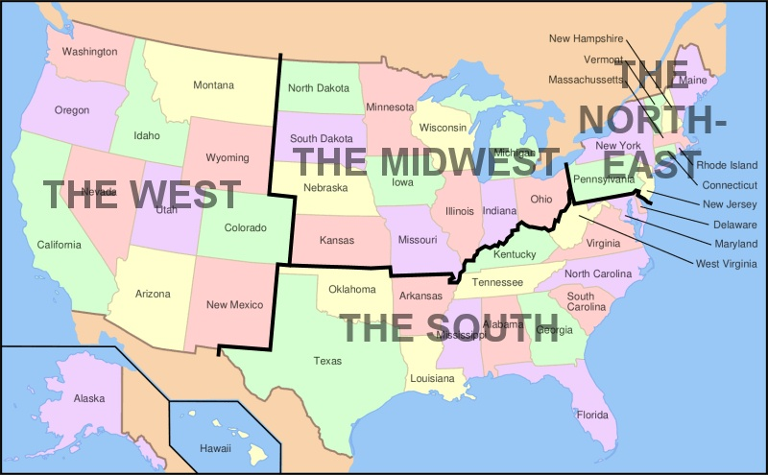
Day 1 I can identify and locate the fifty states of the U.S.
Watch Flocabulary regions
Color the western states on the map in your journal.

Slide 3
Magnetic Labeling Game

Slide 4
Day 2 I can identify and locate the fifty states of the U.S.
Western Region Quiz
Watch Tour the States
Watch Learn the 50 states with Mrs. Alexander
Color the Midwestern states on the map in your journal.

Slide 5
Magnetic Labeling Game

Slide 6
Day 3 I can identify and locate the fifty states of the U.S.
Midwestern Region Quiz
Watch Tour the States
Watch Learn the 50 states with Mrs. Alexander
Color the Southern states on the map in your journal.

Slide 7
Magnetic Labeling Game

Slide 8
Day 4 I can identify and locate the fifty states of the U.S.
South Region Quiz
Watch Tour the States
Watch Learn the 50 states with Mrs. Alexander
Color the Northeastern states on the map in your journal.

Slide 9
Magnetic Labeling Game

Slide 10
Day 5 I can identify and locate the fifty states of the U.S.
Northeastern Region Quiz
Watch Tour the States
Watch Learn the 50 states with Mrs. Alexander

Slide 11
Magnetic Labeling Game

Slide 12
Day 6 I can identify and locate the fifty states of the U.S.
Give the pretest
Watch Tour the States
Watch Learn the 50 states with Mrs. Alexander

Slide 13
Magnetic Labeling Game

Slide 14
Day 7 I can identify and locate the fifty states of the U.S.
Give the 50 States Labeling Test

